Slide 1

Basic course2-Singing
Yahboom
Yahboom OMIBOX Tutorial

Slide 2
1
2
3
4
5
Learning
goals
Search for
blocks
Combine
blocks
Experimental
phenomena
Preparation
程序编程
Tencent
Yahboom OMIBOX Tutorial

Slide 3
1
Preparation-1
1.The position of the buzzer in the robot car
2. Learn how to use buzzer graphically program building blocks
3. Learn how to control RGB light by graphical programming
Yahboom OMIBOX Tutorial

Slide 4
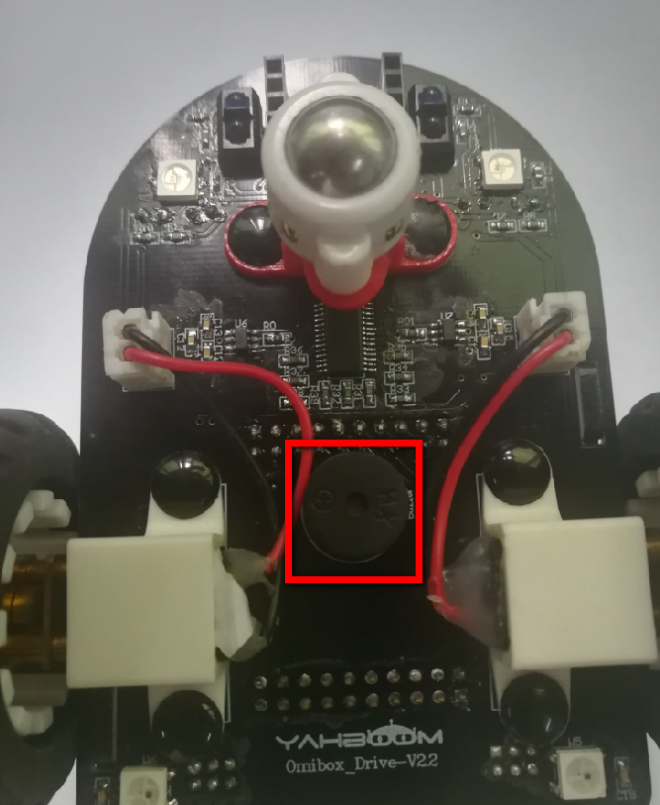
1
Preparation-2
As shown in the figure above, we circled the red wire frame with a buzzer, and we can make it play music by programming.
Yahboom OMIBOX Tutorial

Slide 5
2
Learning goals
In this lesson, we will learn how to use the buzzer on the Omibox and play music.
Yahboom OMIBOX Tutorial

Slide 6
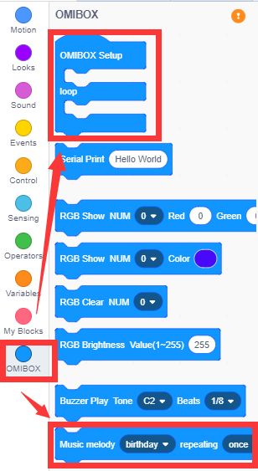
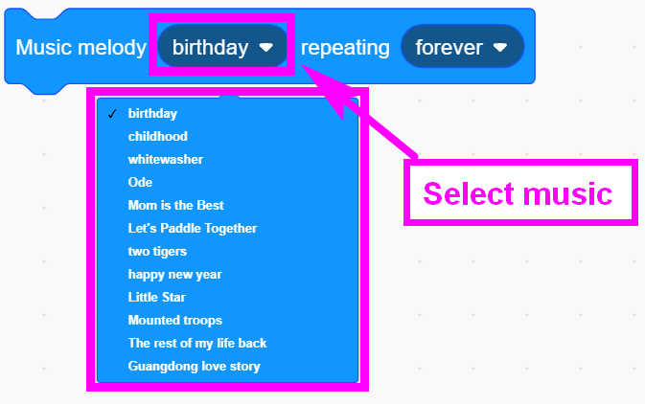
3
Search for blocks
The following is the location of the building blocks required for this programming.
Yahboom OMIBOX Tutorial

Slide 7
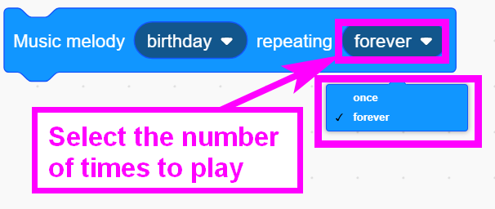
3
Search for blocks
Yahboom OMIBOX Tutorial

Slide 8
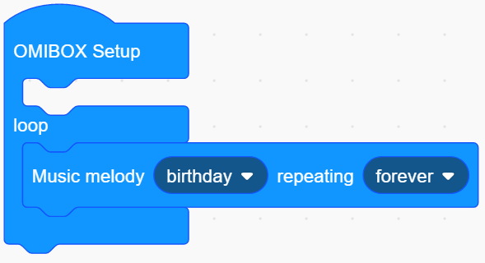
4
Combine blocks
The summary program is shown below:
Yahboom OMIBOX Tutorial

Slide 9
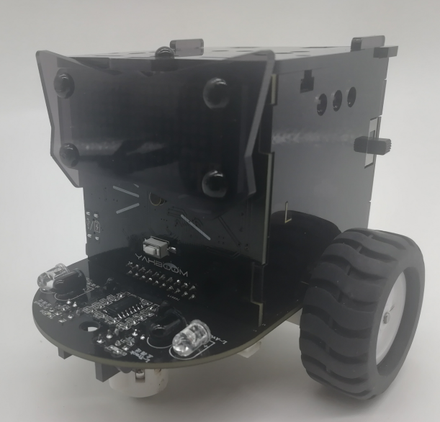
5
Experimental phenomena
After the program is uploaded, the car will be powered up normally, and we can hear the buzzer playing "birthday ".
Yahboom OMIBOX Tutorial

Slide 10
Inspire Creativity Embrace Innovation
Thank you!!!
Yahboom

